Slide 1
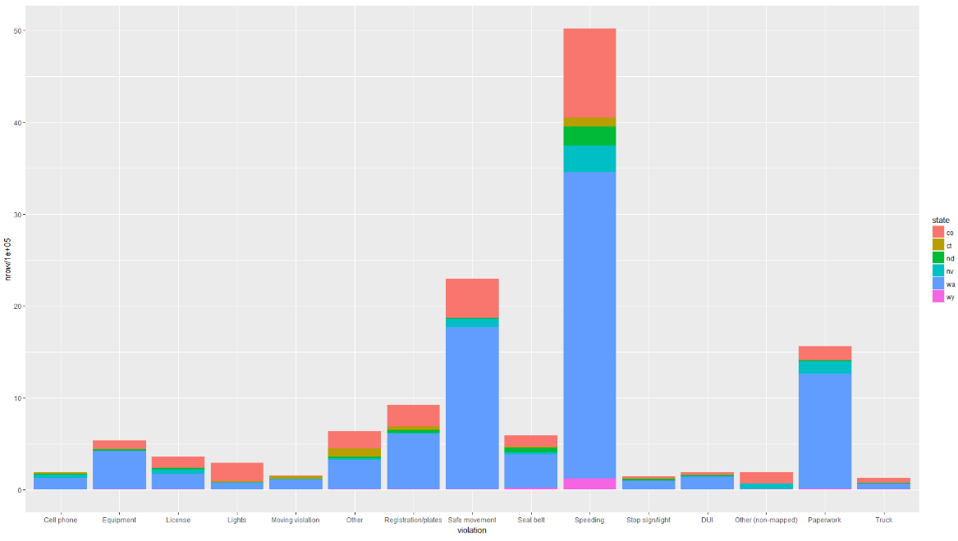
Report – 16/04/2018: Stanford Policing Dataset
In-scope states
5 states including Speeding, Cell Phone, DUI relevant records (Top 3 causes of car accident in USA: speeding, cell phone (text, calling), DUI)
Target 3 states that share the majority of the violation: Colorado, Nevada, Washington
Outline
Age Group Distribution in the licensed driver
Age Group Distribution in the traffic offender
Relevant demographic statics

Slide 2
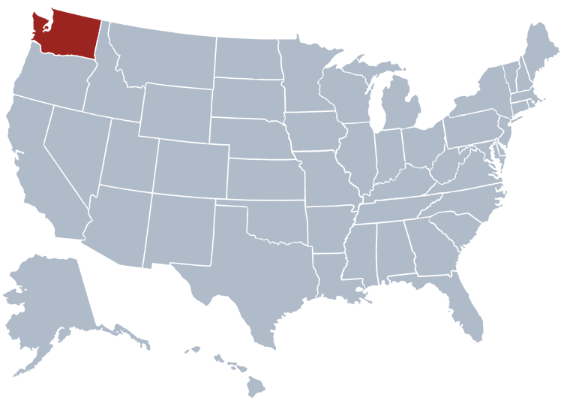
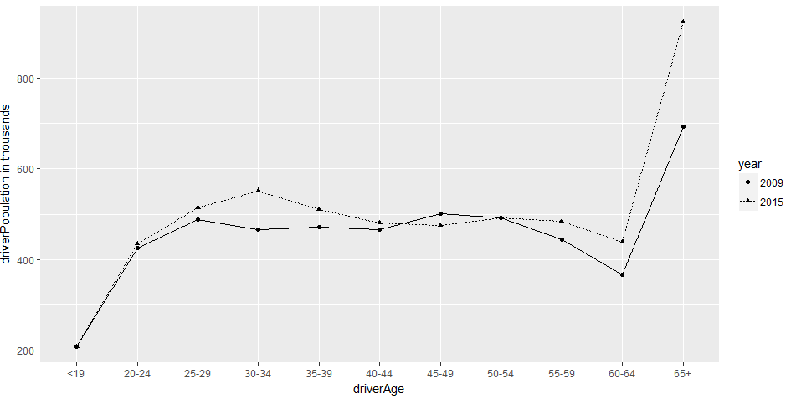
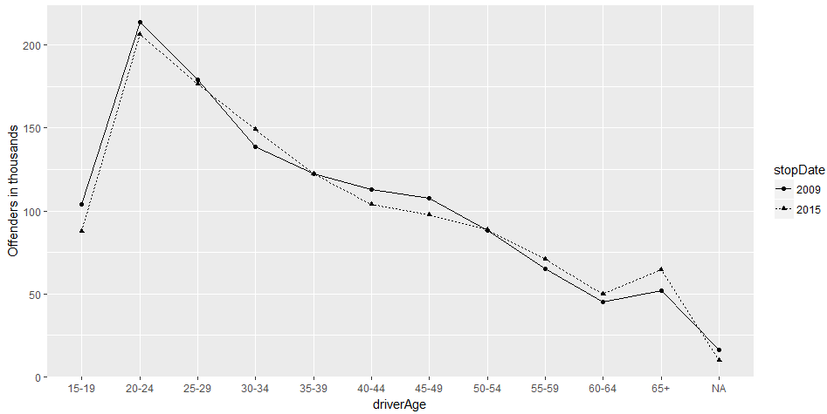
https://www.50states.com
Washington State Licenced Drivers Demography, by Age Group (2009/2015)
Washington State Traffic Offenders Distribution, by Age Group (2009/2015)
Total Licenced Driver: 5,516,134 (2015)
Total Offenders: 1,228,788 (2015)
The licensed driver has a balanced distribution by age group excluding the one under 19 and over 60.
Age group 20-24 contribute the highest traffic offending rate, then 25- 29.
It can be concluded that more elder the driver is, less offending behaviours.

Slide 3
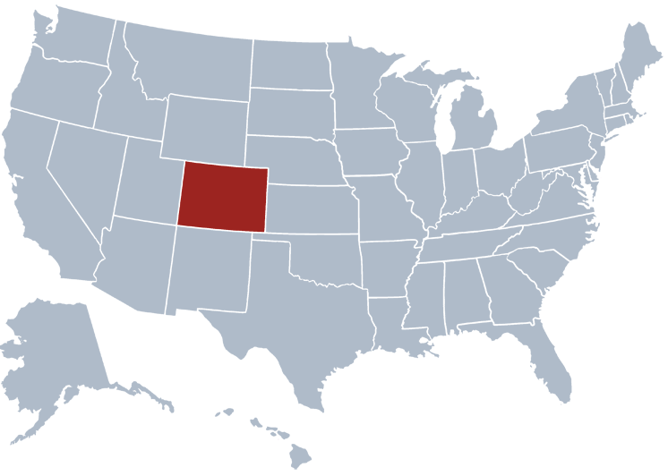
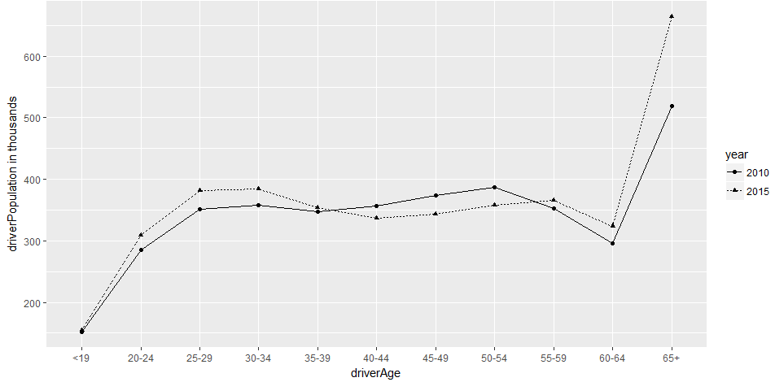
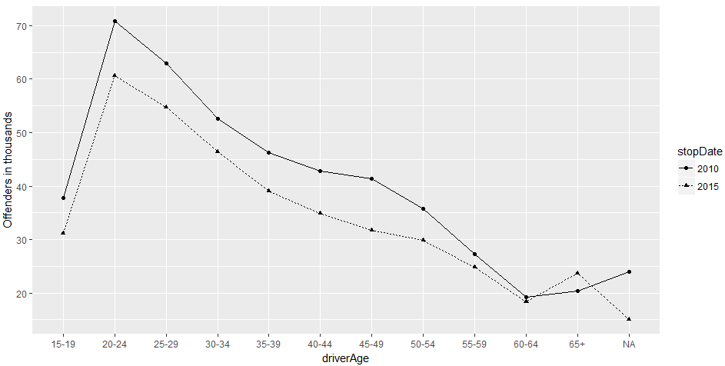
https://www.50states.com
Colorado State Licenced Drivers Demography, by Age Group (2010/2015)
Colorado State Traffic Offenders Distribution, by Age Group (2010/2015)
Total Licenced Driver: 3,974,521 (2015)
Total Offenders: 410,479 (2015)
Similar with Washington state.
The general patrol-stop rate obviously decreased from 2010 to 2015.

Slide 4
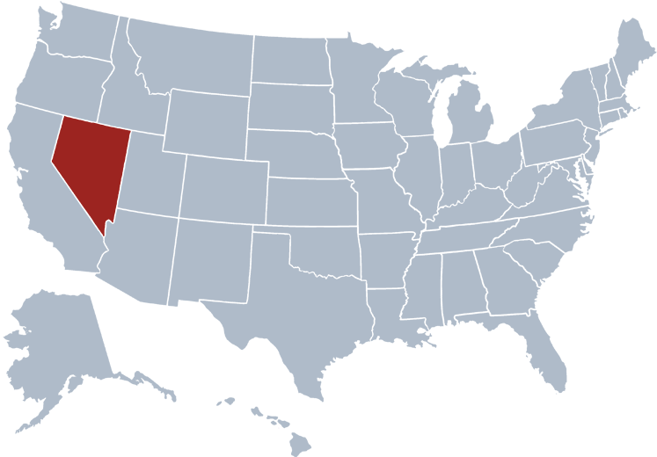
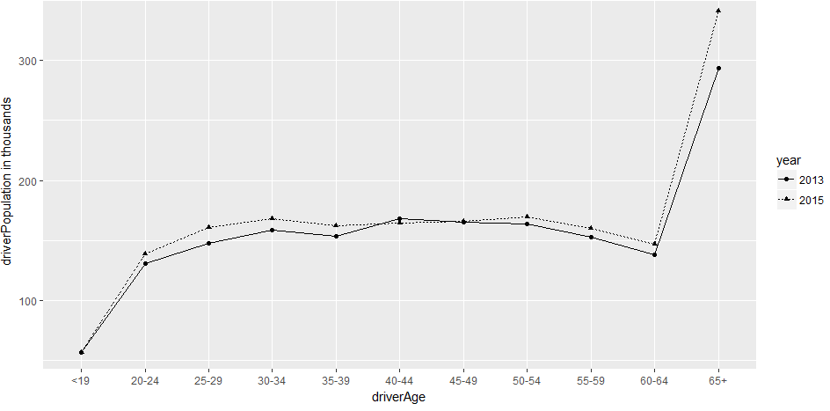
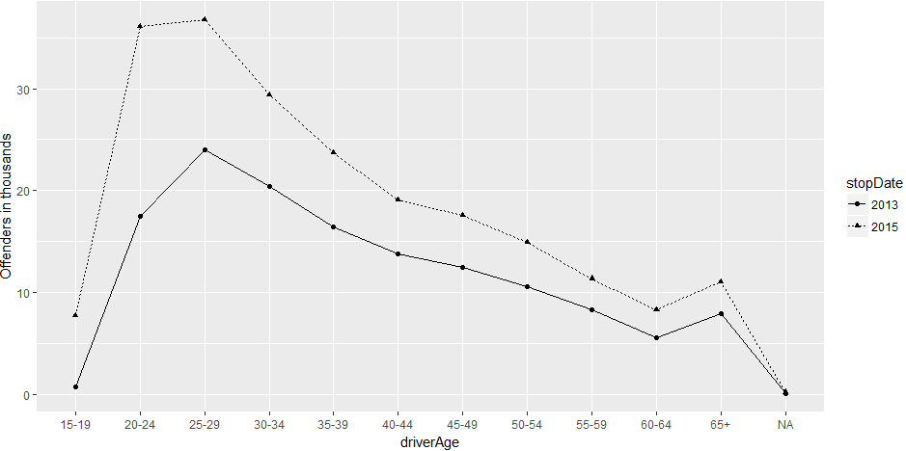
https://www.50states.com
Nevada State Licenced Drivers Demography, by Age Group (2012/2015)
Nevada State Traffic Offenders Distribution, by Age Group (2012/2015)
Total Offenders: 216,477 (2015)
Total Licenced Driver: 341,222 (2015)
The general patrol-stop rate obviously increased from 2013 to 2015.
Different with other two states, age group 25-29 resulted in the highest traffic offending behaviours and then 30-34.

Slide 5
Demographic Overview
State | Population | Licensed Driver | Offenders | % LD ~ P | % O ~ LD | Year
Colorado | 5,029,196 | 3,779,273 | 481,434 | 75.15 | 12.74 | 2010
Nevada | 2,700,551 | 1,728,060 | 138,130 | 63.99 | 7.99 | 2013
Washington | 6,724,540 | 5,026,521 | 1,246,132 | 74.75 | 24.79 | 2009
State | Population | Licensed Driver | Offenders | % LD ~ P | % O ~ LD | Year
Colorado | 5,456,574 | 3,974,521 | 410,479 | 72.84 | 10.33 | 2015
Nevada | 2,890,845 | 1,835,511 | 216,477 | 63.49 | 11.79 | 2015
Washington | 7,170,351 | 5,516,134 | 1,228,788 | 76.93 | 22.28 | 2015
Washington has the biggest population and the highest patrol-stop rate.
Washington has similarity in the percentage of Licenced Driver out of the total population with Colorado state in respective year, however, its traffic offending rate is nearly doubled comparing with Colorado’s.
The traffic offending rate of Nevada is increasing by about 60% within 2 years.
The population of licensed driver of Colorado is more than double of that of Nevada, however, its patrol-stop rate is the least one accordingly.

Slide 6
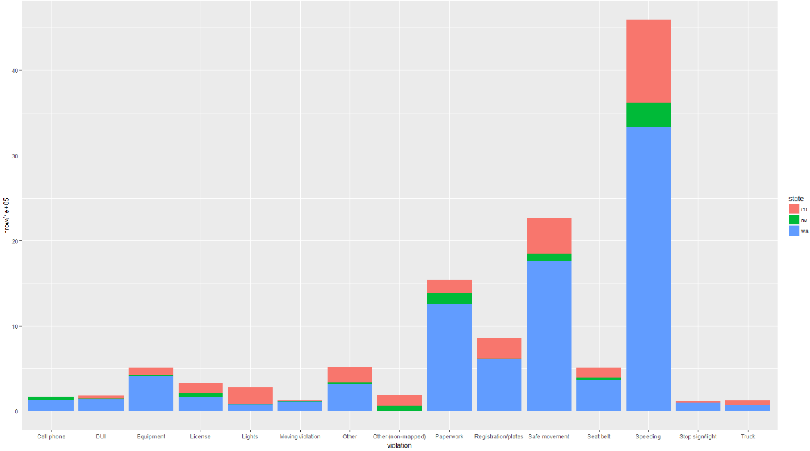
Top 3 Violations:
Speeding
Safe Movement ( car wrecked)
Paperwork
???? Paperwork, involved with DUI or other traffic crimes
???? Safe Movement ( wrecked car) is resulted from speeding, dui, cell phone?
Explore the distribution of Speeding, DUI, Cell Phone with varied age groups

Slide 7
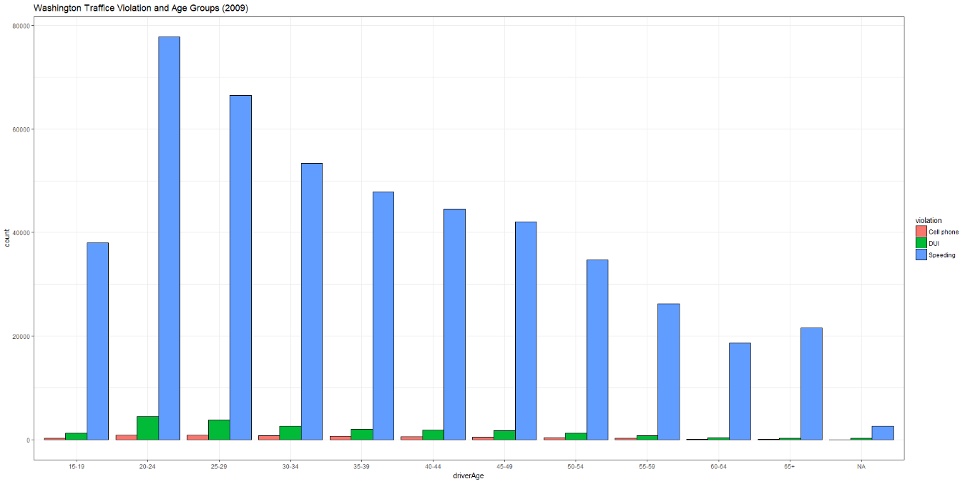
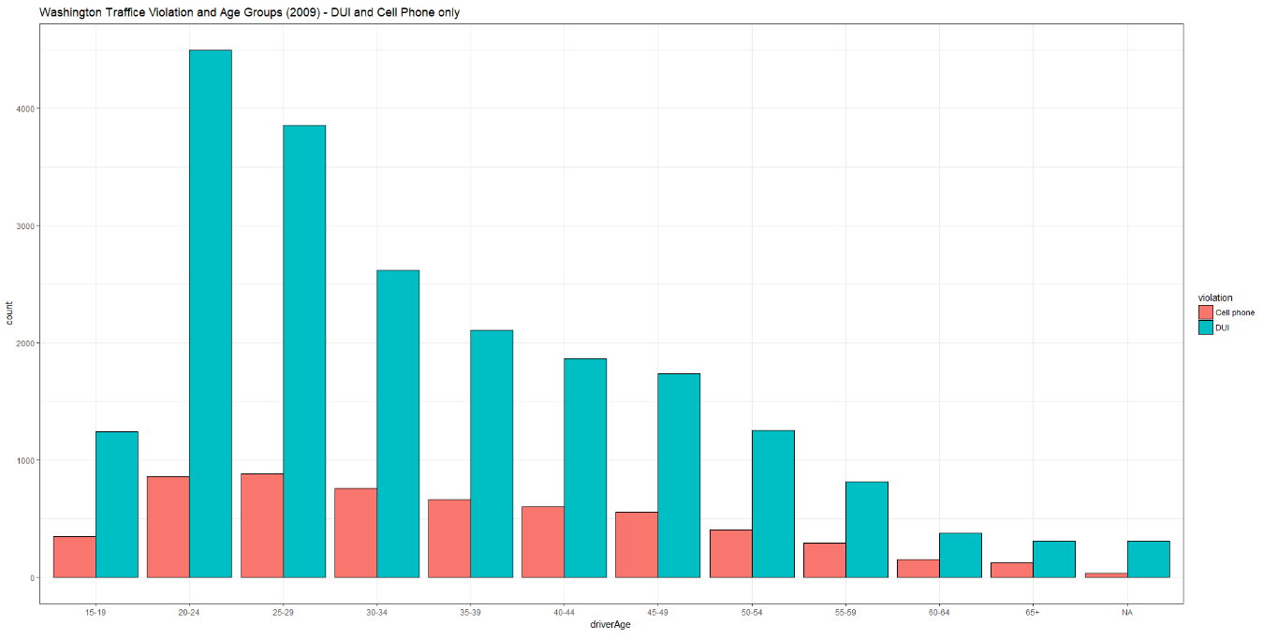
Washington Traffic Violation and Age Groups Distribution (2009)
Similarity exists between speeding and DUI violation, age group 20-24 contribute the highest rate, then 25- 29. It can be concluded that more elder the driver is, less offending behaviours relevant to speeding and dui.
Considering using the Cell phone using while driving, nearly the same frequency of this behaviours among the drivers between 20-29. It decreasing very slightly when the age is increasing until 49. For the driver over than 50, it is nearly 1/3 reduction in the amount according to the next elder group. It could be told that using cell phone for texting is a common violation among drivers from age 20-60.

Slide 8
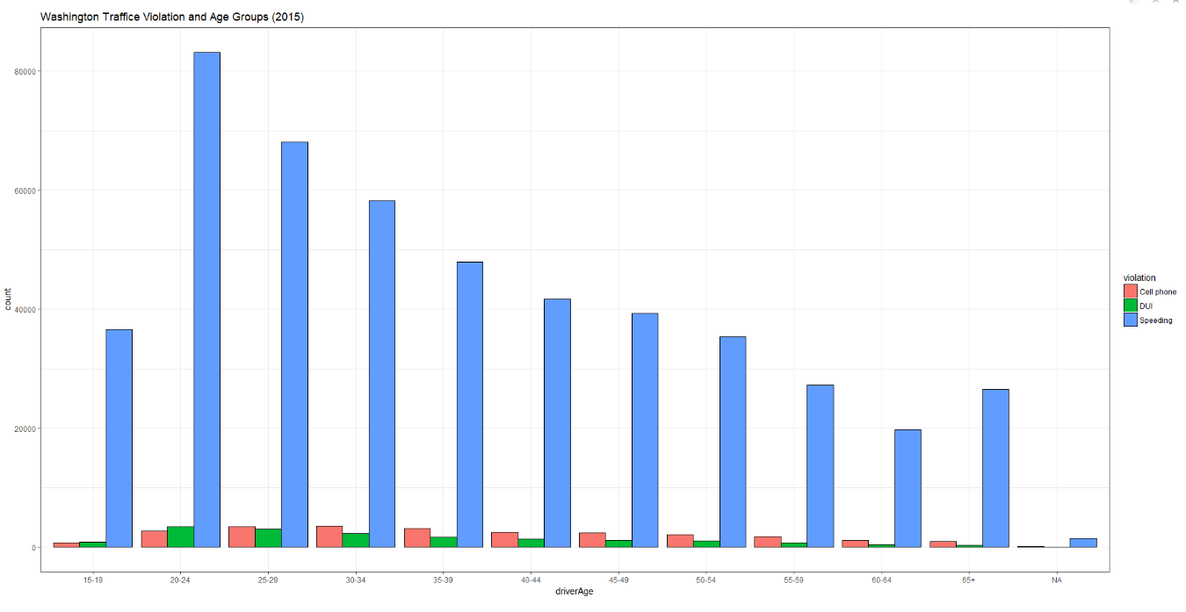
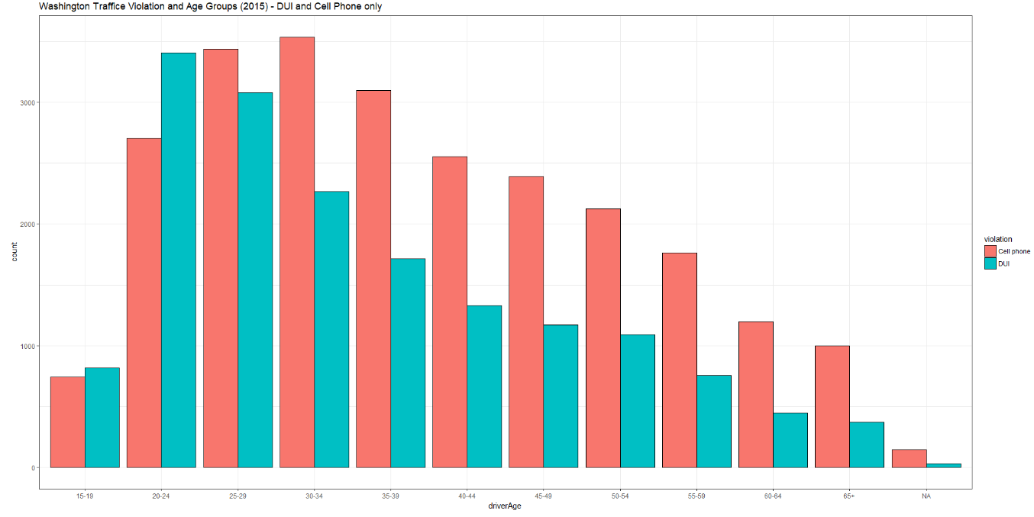
Washington Traffic Violation and Age Groups Distribution (2015)
Similarity exists between speeding and DUI violation, age group 20-24 contribute the highest rate, then 25- 29. It can be concluded that more elder the driver is, less offending behaviours relevant to speeding and dui.
Considering using the Cell phone using while driving, nearly the same frequency of this behaviours among the drivers between 20-29. It decreasing very slightly when the age is increasing until 49. For the driver over than 50, it is nearly 1/3 reduction in the amount according to the next elder group. It could be told that using cell phone for texting is a common violation among drivers from age 20-60.

Slide 9
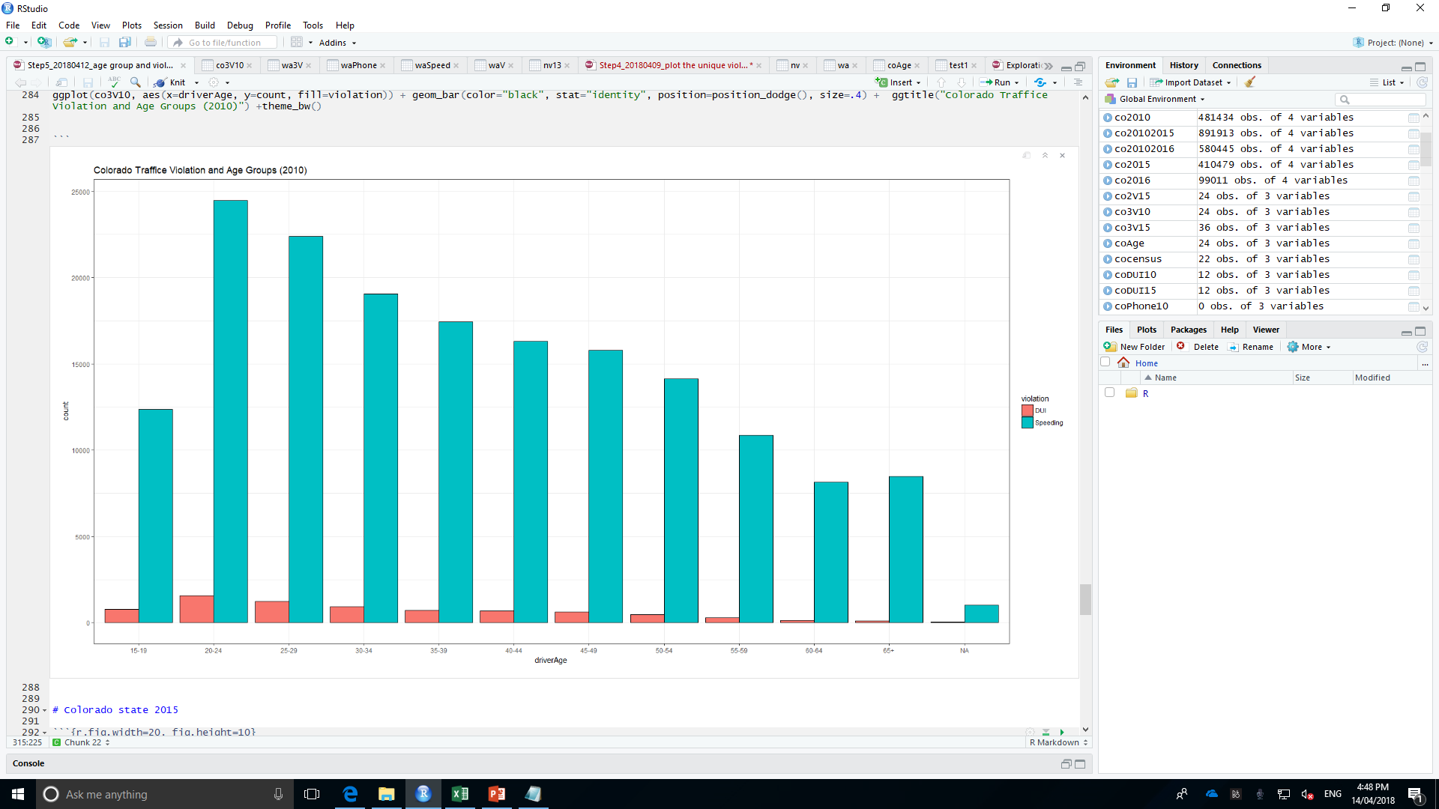

Slide 10
